Slide 1



NEW BANK ACCOUNT OPENING
Team : RRV
T. Rakesh (Team Leader)
D. Rami Reddy (Team Member)
G. Vennela (Team Member)
Trainer
Ms. Vishruti Prajapati

Slide 2






INTRODUCTION
In the present world everywork is done digitally by saving peoples time. The New Bank Account opening is also an automation process of opening bank account online for customers across different countries to open an account.

Slide 3
REQUIREMENTS
ABC Bank want to automate the account opening process in their bank. In the first release the bank wants to move with opening a Saving bank account. As an initial level design, the customers from different countries from the regions like Asia, America, Europe and Australia can open the savings account. Based on the region the customer has to enter the ID proof details (Aadhar Card-Indian, USA SSN Number-American, European SSN or Tax File Number (TFN)- European country) which are mandatory to open an account.

Slide 4

Topics Covered
Case Lifecycle Routing
Service level Agreement
Multi-step form
Adding fields to a case type Manipulating case data Calculating case Values Validating case data
Data pages
Data Transform
Report Definition
Optional actions

Slide 5






Customer
Kit Dispatch Department
Verification Team
C a s e workers
Manager
Delivery Boy

Slide 6




















WorkFlow
Provide Details
Verify Details
Manger
approval
New User
Send Email
HOME
Kit delivery
Kit Generation
Feedback
Existing User
Login
Update

Slide 7
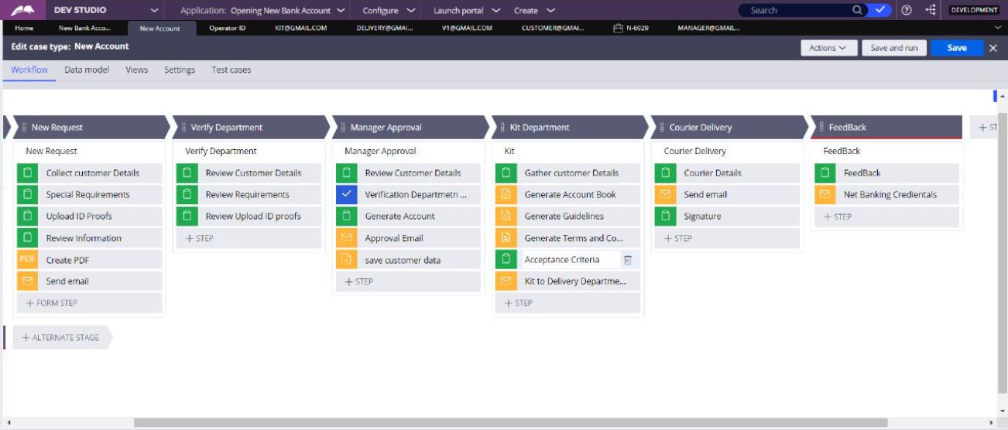
Case Life Cycle

Slide 8
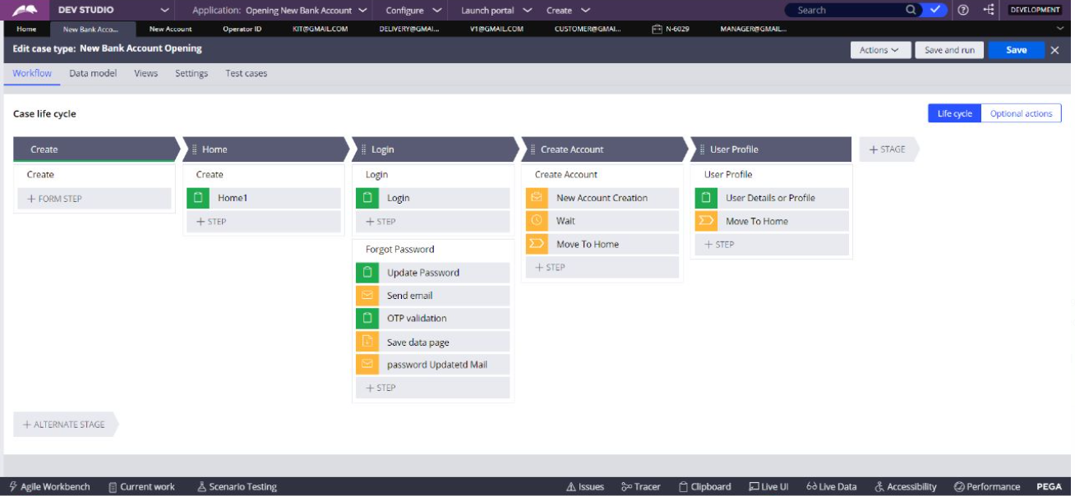

Slide 9


